Slide 1
Spark:Importance of Spark Framework, Components of the Spark unified stack,
Batch and Real-Time Analytics with Apache Spark, Resilient Distributed Dataset
(RDD),
Scala: Scala,Environment Set up, Downloading and installing Spark standalone, Functional
Programming, Collections.

Slide 2
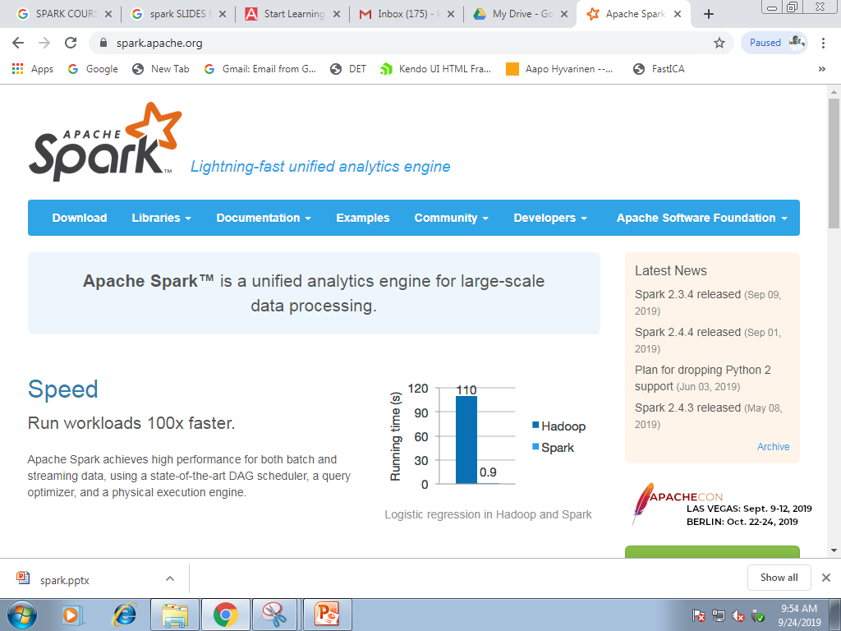

Slide 3
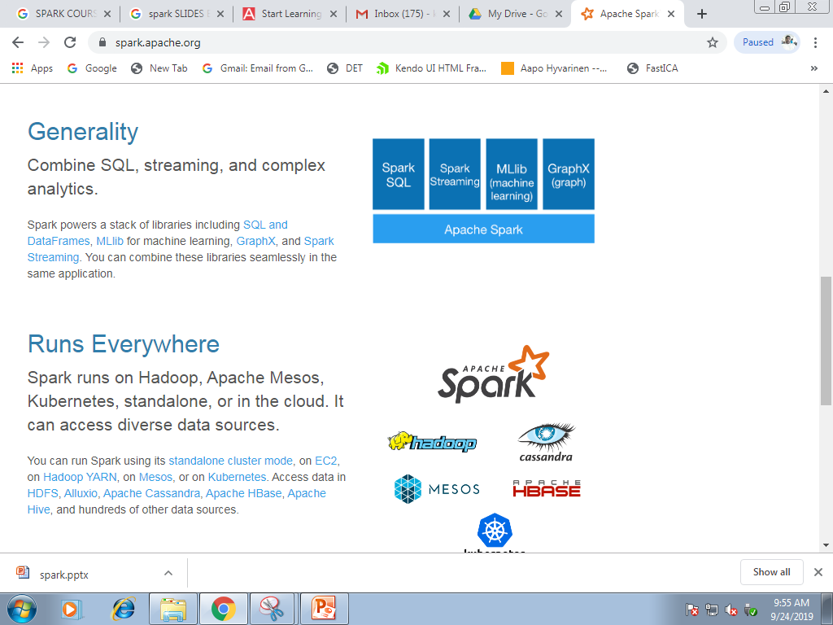


Slide 4
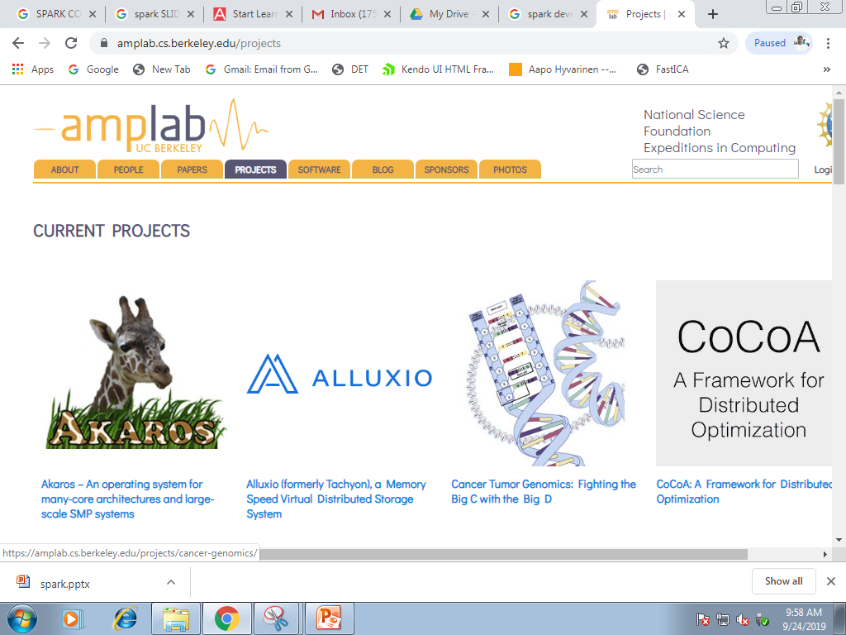

Slide 5
What is Apache Spark?
Fast and general cluster computing system, interoperable with Hadoop, included in all major distros
Improves efficiency through:
In-memory computing primitives
General computation graphs
Improves usability through:
Rich APIs in Scala, Java, Python
Interactive shell
Up to 100× faster
(2-10× on disk)
2-5× less code

Slide 6
Spark Model
Write programs in terms of transformations on distributed datasets
Resilient Distributed Datasets (RDDs)
Collections of objects that can be stored in memory or disk across a cluster
Parallel functional transformations (map, filter, …)
Automatically rebuilt on failure

Slide 7


On-Disk Sort Record: Time to sort 100TB
2013 Record: Hadoop
2100 machines
72 minutes
2014 Record: Spark
207 machines
23 minutes
Also sorted 1PB in 4 hours
Source: Daytona GraySort benchmark, sortbenchmark.org

Slide 8
Components of Spark

Slide 9
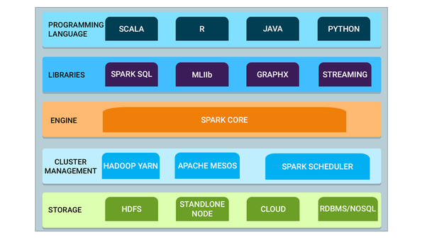

Slide 10
Spark Core — Spark Core is the base engine for large-scale parallel and distributed data processing. Further, additional libraries which are built on top of the core allow diverse workloads for streaming, SQL, and machine learning. It is responsible for memory management and fault recovery, scheduling, distributing and monitoring jobs on a cluster & interacting with storage systems.

Slide 11
Cluster management — A cluster manager is used to acquire cluster resources for executing jobs. Spark core runs over diverse cluster managers including Hadoop YARN, Apache Mesos, Amazon EC2 and Spark’s built-in cluster manager. The cluster manager handles resource sharing between Spark applications. On the other hand, Spark can access data in HDFS, Cassandra, HBase, Hive, Alluxio, and any Hadoop data source

Slide 12
Spark Streaming — Spark Streaming is the component of Spark which is used to process real-time streaming data.

Slide 13
Spark SQL: Spark SQL is a new module in Spark which integrates relational processing with Spark’s functional programming API. It supports querying data either via SQL or via the Hive Query Language. The DataFrame and Dataset APIs of Spark SQL provide a higher level of abstraction for structured data.

Slide 14
GraphX: GraphX is the Spark API for graphs and graph-parallel computation. Thus, it extends the Spark RDD with a Resilient Distributed Property Graph.

Slide 15
MLlib (Machine Learning): MLlib stands for Machine Learning Library. Spark MLlib is used to perform machine learning in Apache Spark.

Slide 16
Resilient Distributed Datasets
(RDD)

Slide 17
What is RDD?
Resilient Distributed Dataset(RDD)
RDDs are the building blocks of any Spark application. RDDs Stands for:
Resilient: Fault tolerant and is capable of rebuilding data on failure
Distributed: Distributed data among the multiple nodes in a cluster
Dataset: Collection of partitioned data with values
It is a layer of abstracted data over the distributed collection. It is immutable in nature and follows lazy transformations.

Slide 18
the data in an RDD is split into chunks based on a key.
RDDs are highly resilient, i.e, they are able to recover quickly from any issues as the same data chunks are replicated across multiple executor nodes.
even if one executor node fails, another will still process the data. This allows you to perform your functional calculations against your dataset very quickly by harnessing the power of multiple nodes.
once you create an RDD it becomes immutable. By immutable I mean, an object whose state cannot be modified after it is created, but they can surely be transformed.

Slide 19
Formally, an RDD is a read-only, partitioned collection of records. RDDs can be created through deterministic operations on either data on stable storage or other RDDs. RDD is a fault-tolerant collection of elements that can be operated on in parallel.

Slide 20
In the spark distributed environment, each dataset in RDD is divided into logical partitions, which may be computed on different nodes of the cluster. Due to this, you can perform transformations or actions on the complete data parallelly.

Slide 21
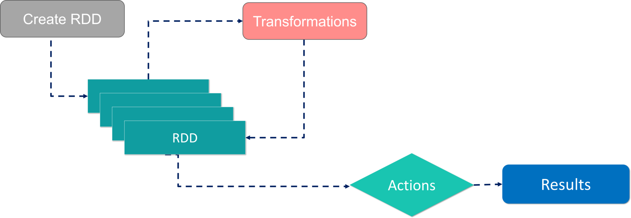

Slide 22
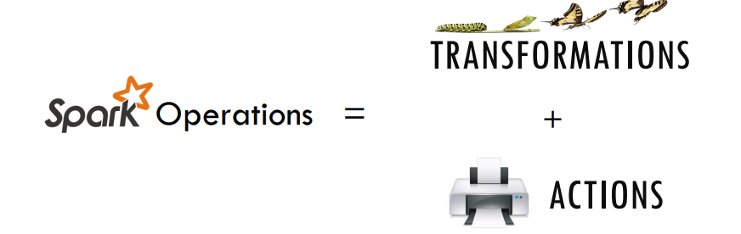

Slide 23
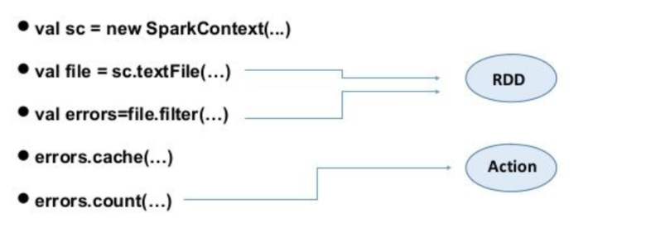

Slide 24
There are two ways to create RDDs − parallelizing an existing collection in your driver program, or by referencing a dataset in an external storage system, such as a shared file system, HDFS, HBase, etc.
With RDDs, you can perform two types of operations:
Transformations: They are the operations that are applied to create a new RDD.
Actions: They are applied on an RDD to instruct Apache Spark to apply computation and pass the result back to the driver.

Slide 25
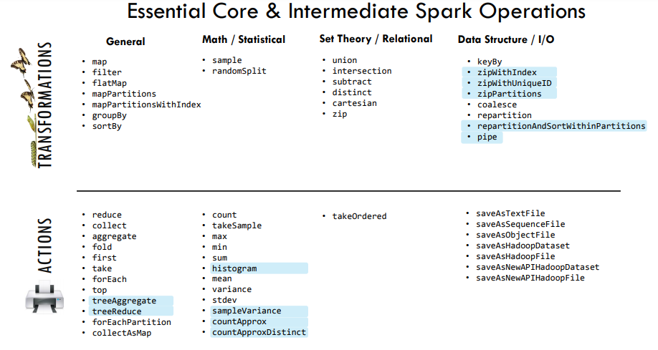

Slide 26
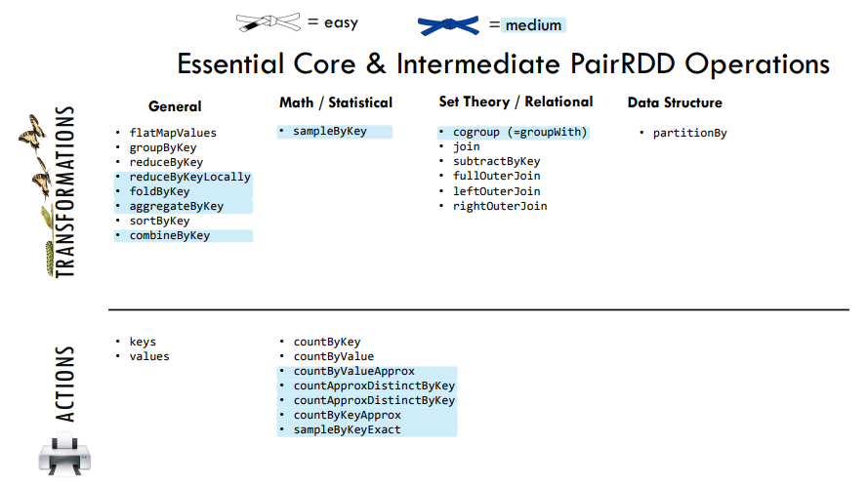

Slide 27
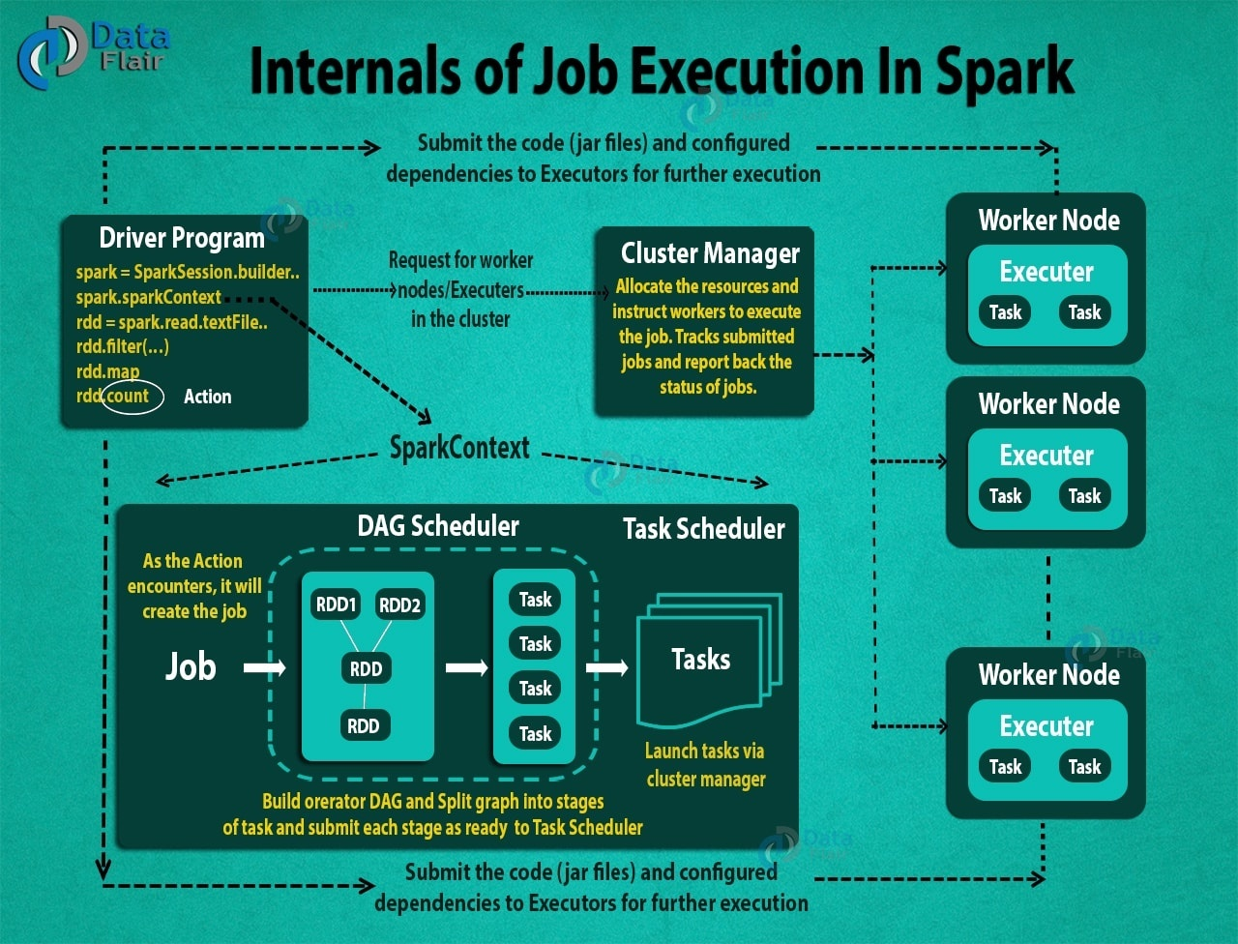

Slide 28
Flow of execution
STEP 1: The client submits spark user application code. When an application code is submitted, the driver implicitly converts user code that contains transformations and actions into a logically directed acyclic graph called DAG. At this stage, it also performs optimizations such as pipelining transformations.

Slide 29
STEP 2: After that, it converts the logical graph called DAG into physical execution plan with many stages. After converting into a physical execution plan, it creates physical execution units called tasks under each stage. Then the tasks are bundled and sent to the cluster.

Slide 30
STEP 3: Now the driver talks to the cluster manager and negotiates the resources. Cluster manager launches executors in worker nodes on behalf of the driver. At this point, the driver will send the tasks to the executors based on data placement. When executors start, they register themselves with drivers. So, the driver will have a complete view of executors that are executing the task.

Slide 31
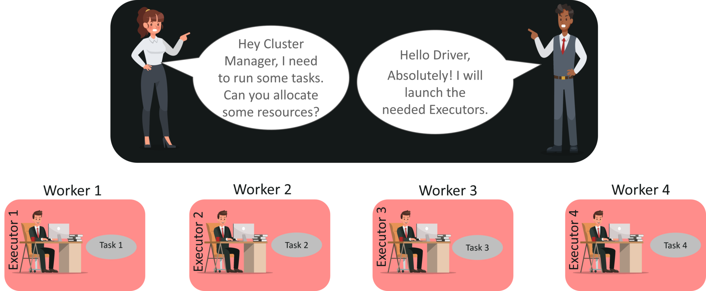

Slide 32
STEP 4: During the course of execution of tasks, driver program will monitor the set of executors that runs. Driver node also schedules future tasks based on data placemen

Slide 33
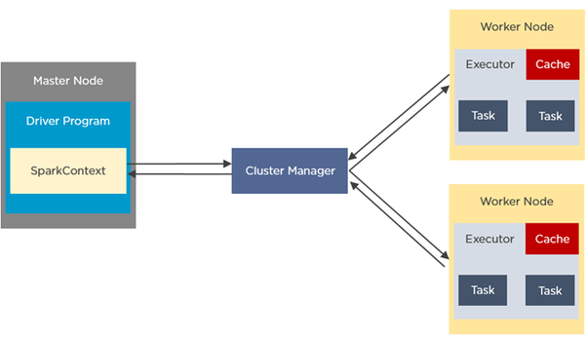

Slide 34
In your master node, you have the driver program, which drives your application. The code you are writing behaves as a driver program or if you are using the interactive shell, the shell acts as the driver program.
Inside the driver program, the first thing you do is, you create a Spark Context. Assume that the Spark context is a gateway to all the Spark functionalities. It is similar to your database connection. Any command you execute in your database goes through the database connection. Likewise, anything you do on Spark goes through Spark context.

Slide 35
Now, this Spark context works with the cluster manager to manage various jobs. The driver program & Spark context takes care of the job execution within the cluster. A job is split into multiple tasks which are distributed over the worker node. Anytime an RDD is created in Spark context, it can be distributed across various nodes and can be cached there.
Worker nodes are the slave nodes whose job is to basically execute the tasks. These tasks are then executed on the partitioned RDDs in the worker node and hence returns back the result to the Spark Context.

Slide 36
Spark Context takes the job, breaks the job in tasks and distribute them to the worker nodes. These tasks work on the partitioned RDD, perform operations, collect the results and return to the main Spark Context.
If you increase the number of workers, then you can divide jobs into more partitions and execute them parallel over multiple systems. It will be a lot faster.
With the increase in the number of workers, memory size will also increase & you can cache the jobs to execute it faster.

Slide 37
executor
The individual task in the given Spark job runs in the Spark executors. Executors are launched once in the beginning of Spark Application and then they run for the entire lifetime of an application. Even if the Spark executor fails, the Spark application can continue with ease. There are two main roles of the executors:
Runs the task that makes up the application and returns the result to the driver.
Provide in-memory storage for RDDs that are cached by the user.

Slide 38
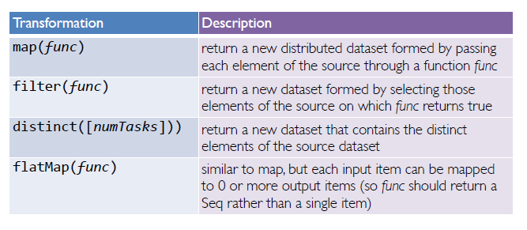
some transformations

Slide 39
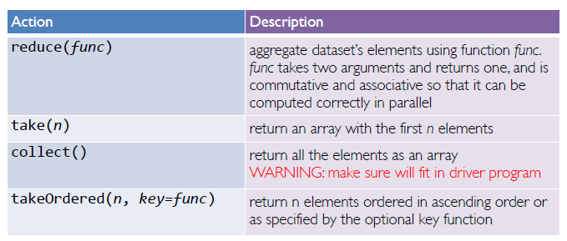
Actions

Slide 40
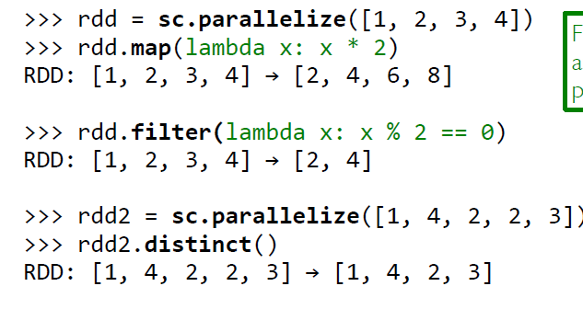
examples

Slide 41
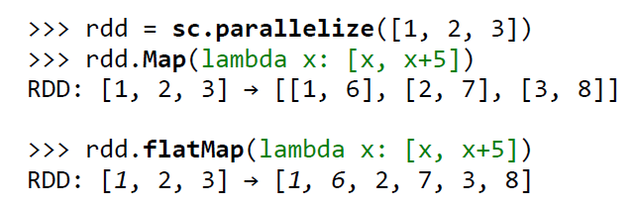
examples

Slide 42
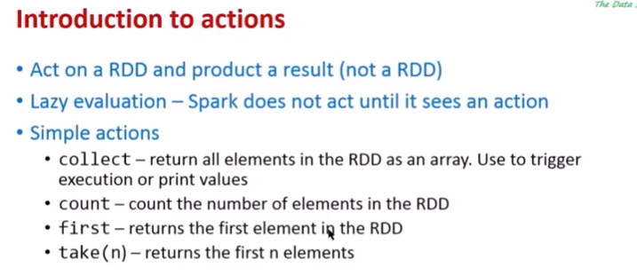

Slide 43
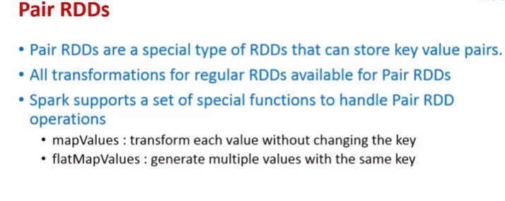

Slide 44
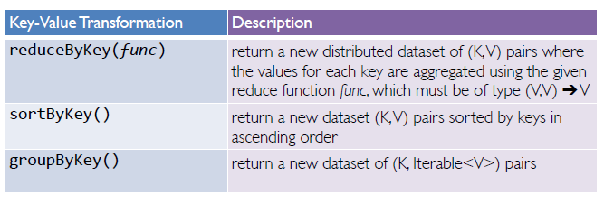
Some key value Transformations

Slide 45
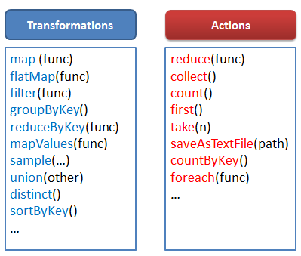

Slide 46
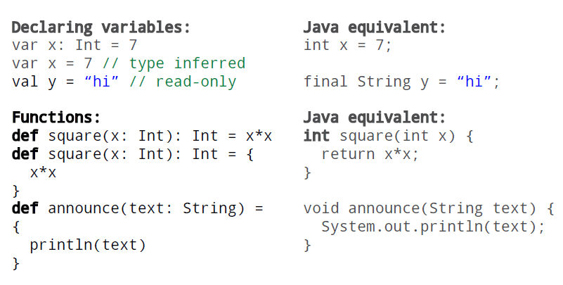
scala

Slide 47
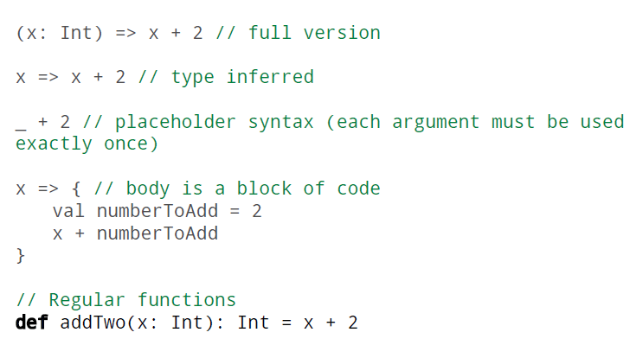
Scala functions

Slide 48
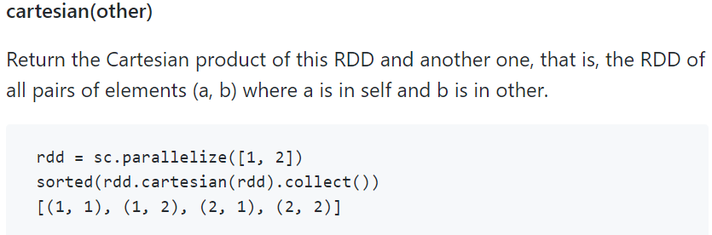

Slide 49
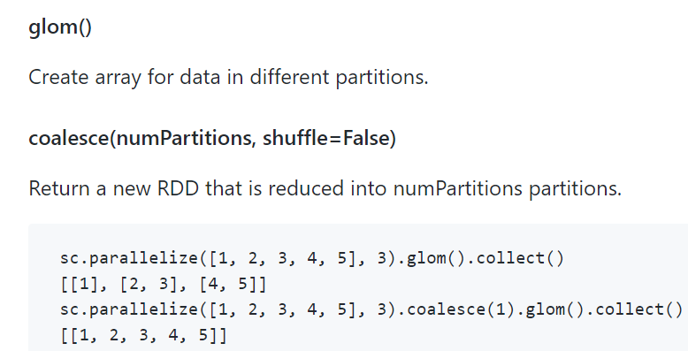

Slide 50
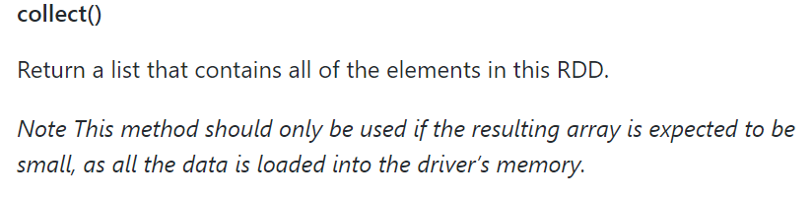

Slide 51
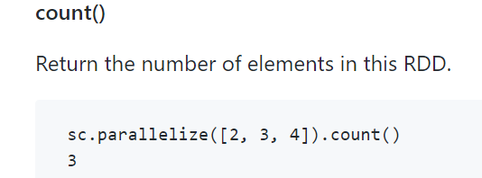
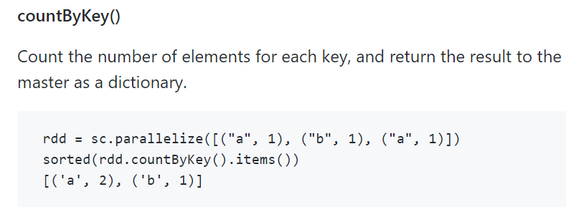

Slide 52
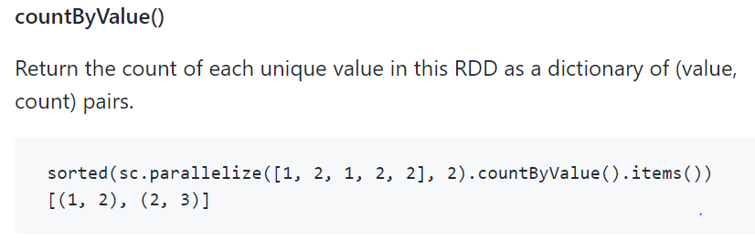

Slide 53
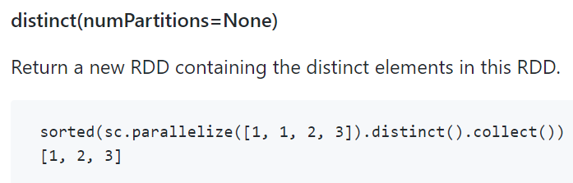
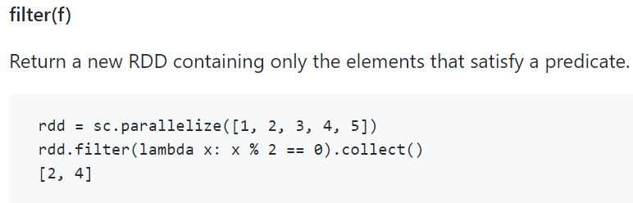

Slide 54
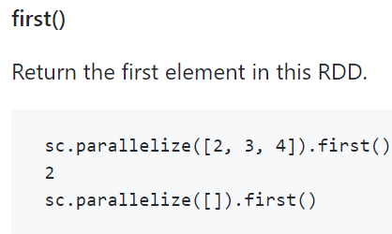
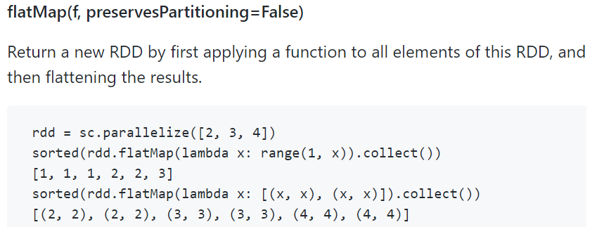

Slide 55
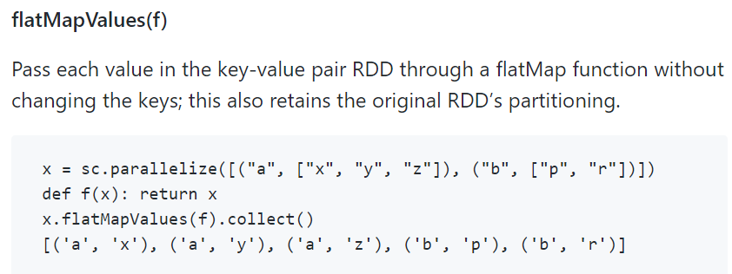
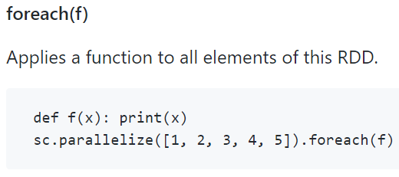

Slide 56
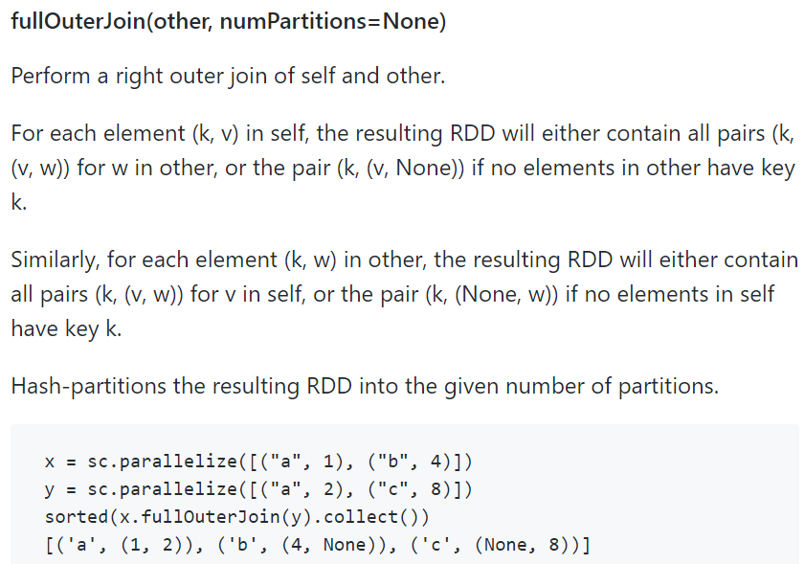

Slide 57
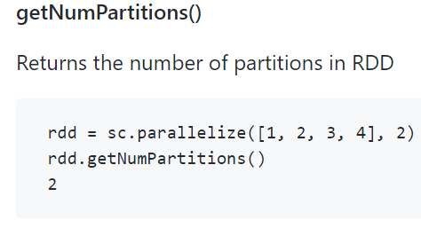
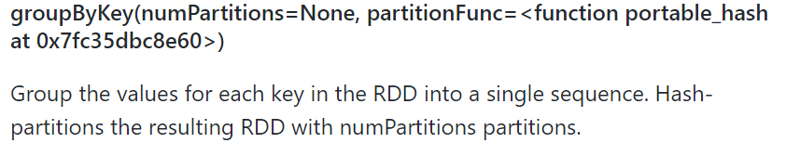
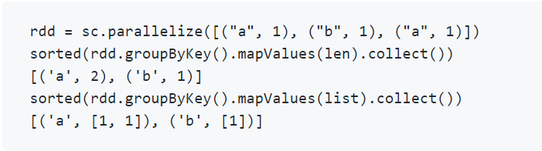

Slide 58
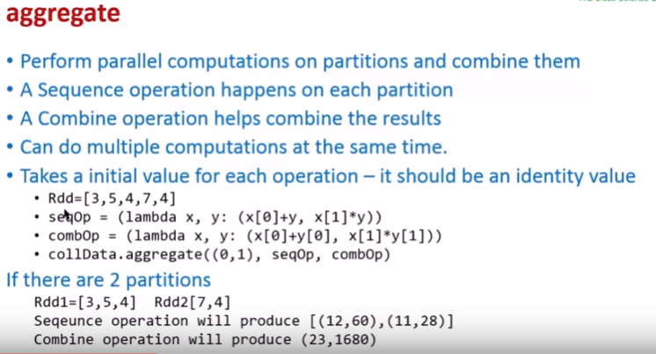

Slide 59
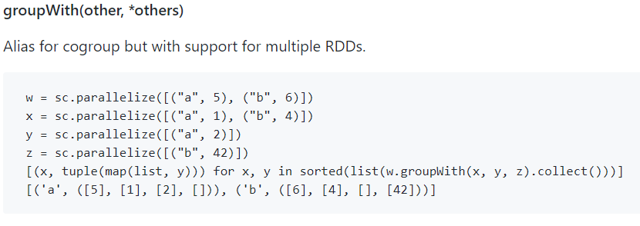

Slide 60
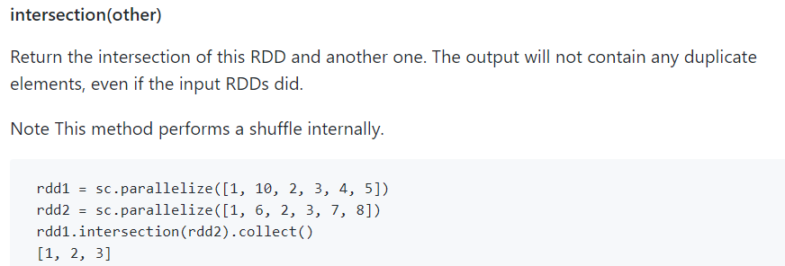

Slide 61
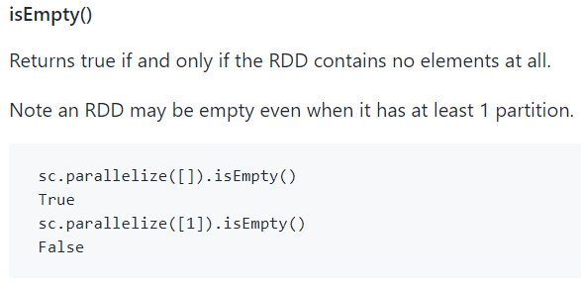

Slide 62
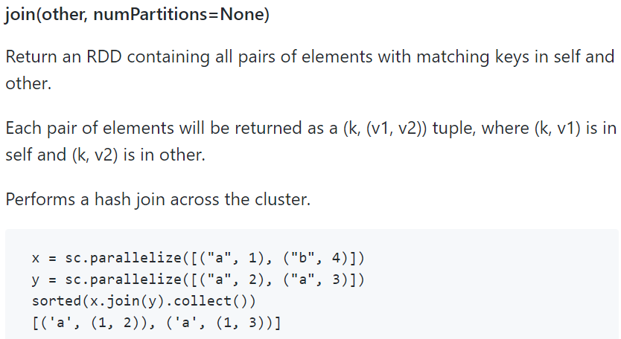

Slide 63
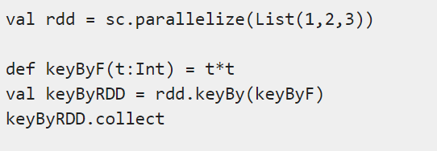
keyBy

Slide 64
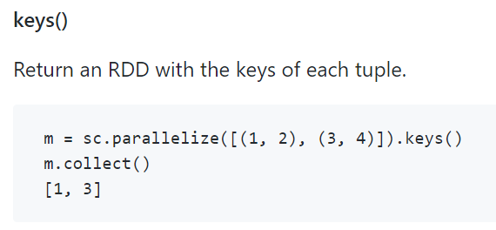

Slide 65
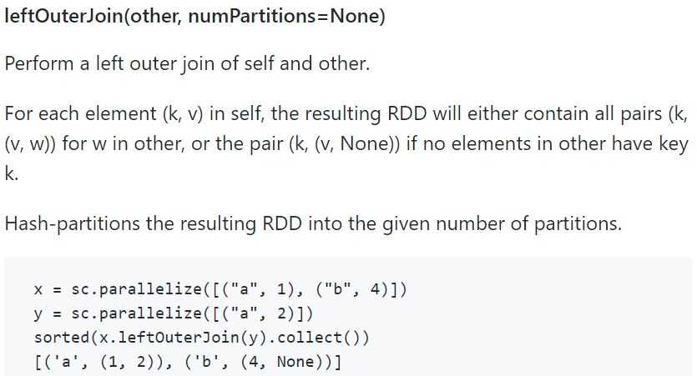

Slide 66
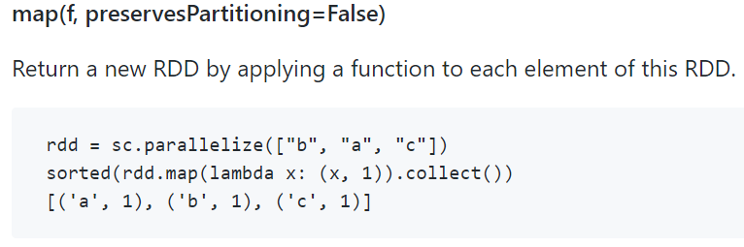
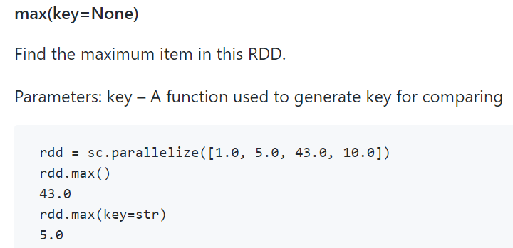

Slide 67
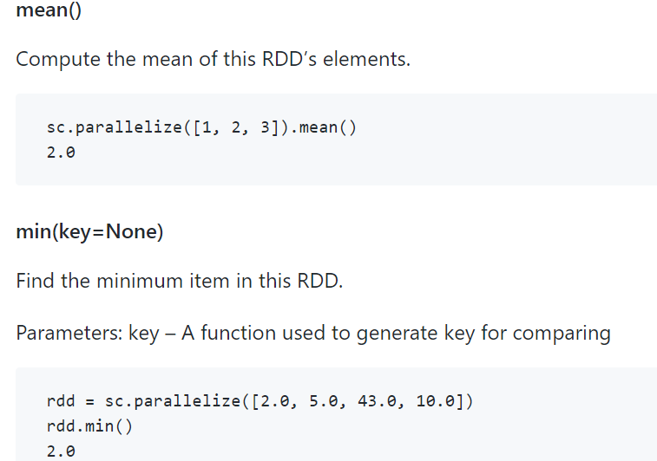

Slide 68
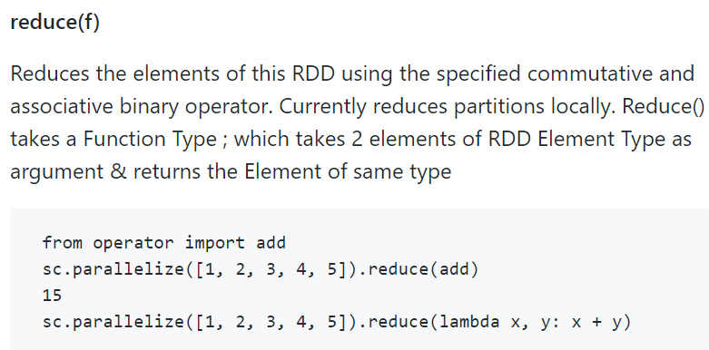

Slide 69


